Slide 1

How does population, income, number of bedrooms affect housing prices in the area?
Group 2

Slide 2
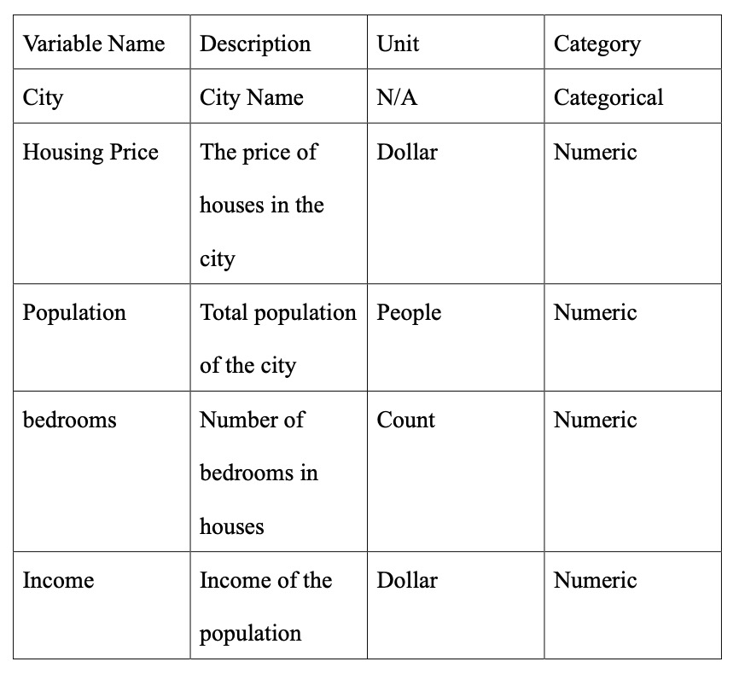
Summary
Motivation of Study
Real Estate Companies
Financial Institutions
Government Agencies
Urban Planners
Two Data Set
realtor-data.csv & USA_Housing.csv
Merging Strategy
zip_code
Target Variable
Housing Price (Price) : Continuous, regression problem
Key predictors include
• Avg.Area.Income
• Area.Population
• Avg.Area.Number.of.Bedrooms
Hongbei Li 527852

Slide 3
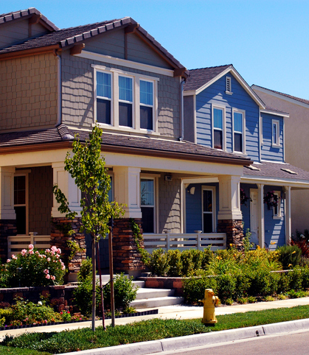
Literature Review
Key Points:
1. Population:
- Growth positively correlates with housing prices (Glaeser & Gyourko, 2005).
- Larger populations drive higher demand and prices (Mankiw & Weil, 1989).
2. Income:
- A core determinant of housing prices (Sirmans et al., 2005).
- Geographic income variation impacts market segmentation (Case & Shiller, 2003).
3. Housing Attributes:
- Limited impact compared to income and location (Goodman & Thibodeau, 2003).
- Auxiliary role in property value (Rosen, 1974).
Contribution:
- Empirical validation of existing theories; highlights primary and secondary variables.
Hongbei Li 527852

Slide 4
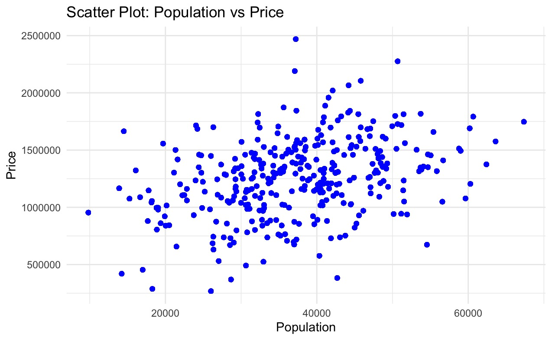
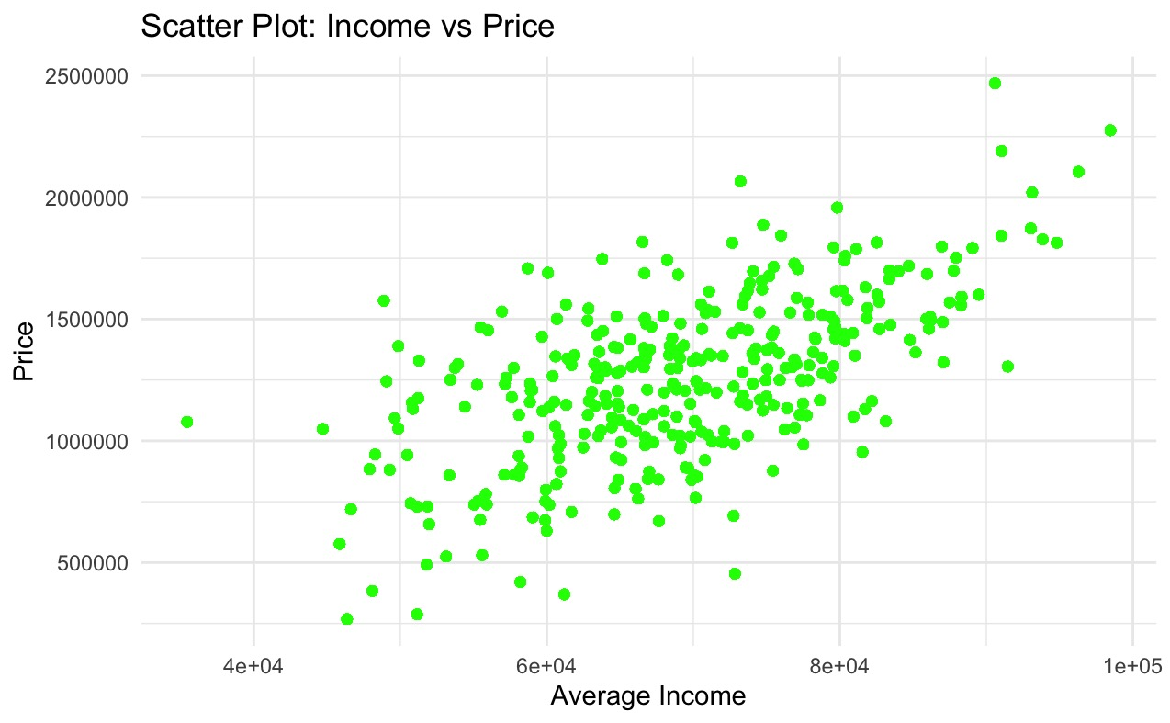
Descriptive Analysis
Scatter Plot
Population vs Price
Income vs Price

Slide 5
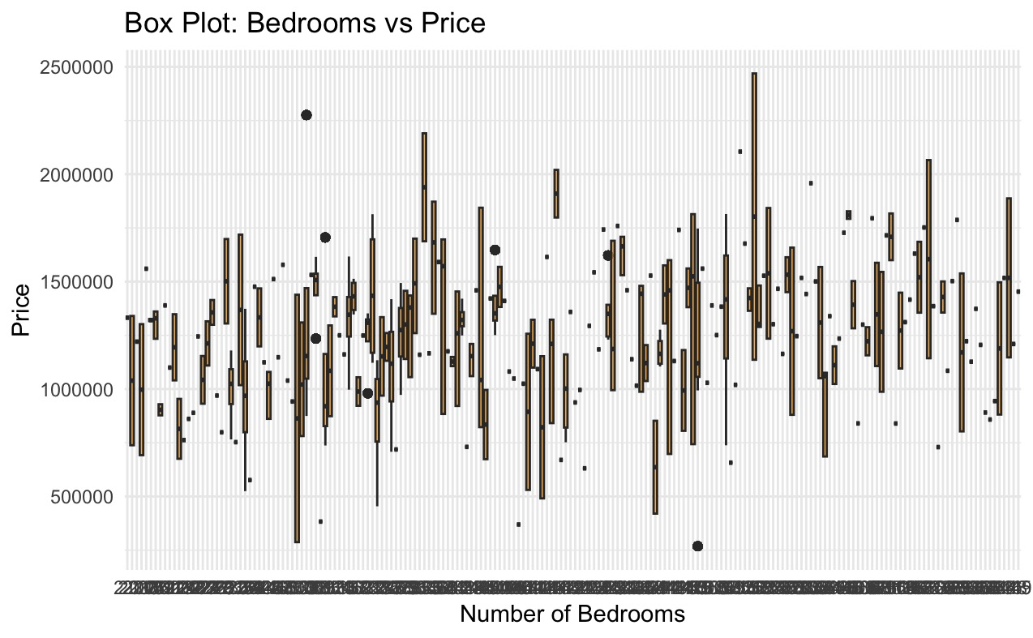
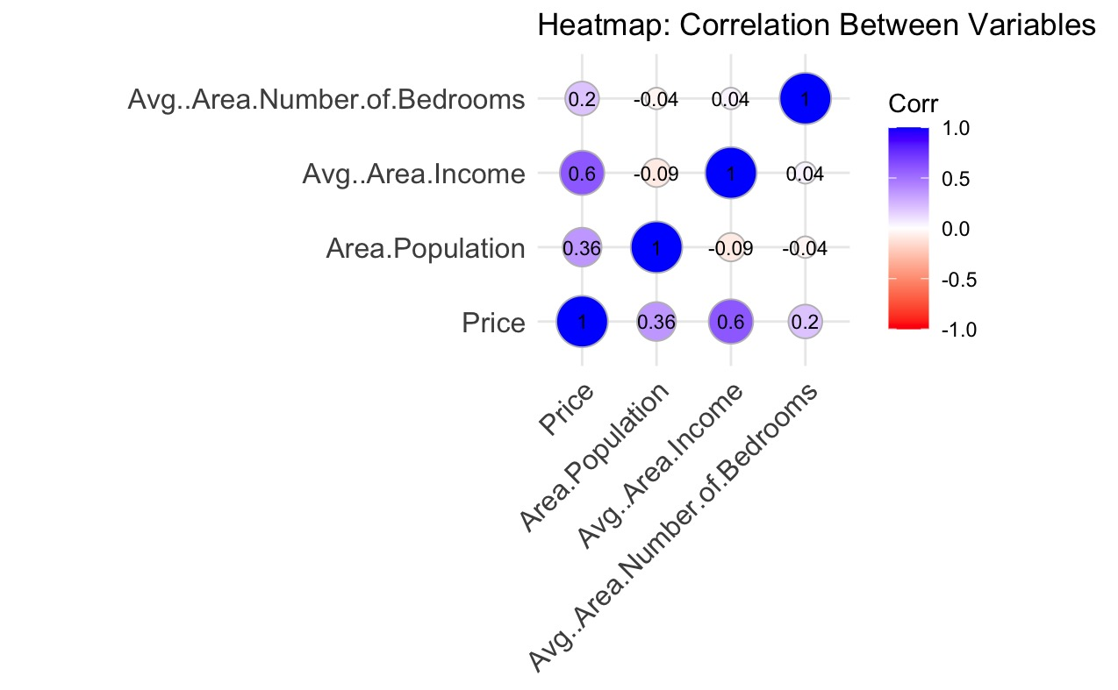
Box Plot
Heatmap
Bedrooms vs Price
Correlation Between Variables
Income (0.60)
Population (0.36)
Bedrooms (0.20)

Slide 6
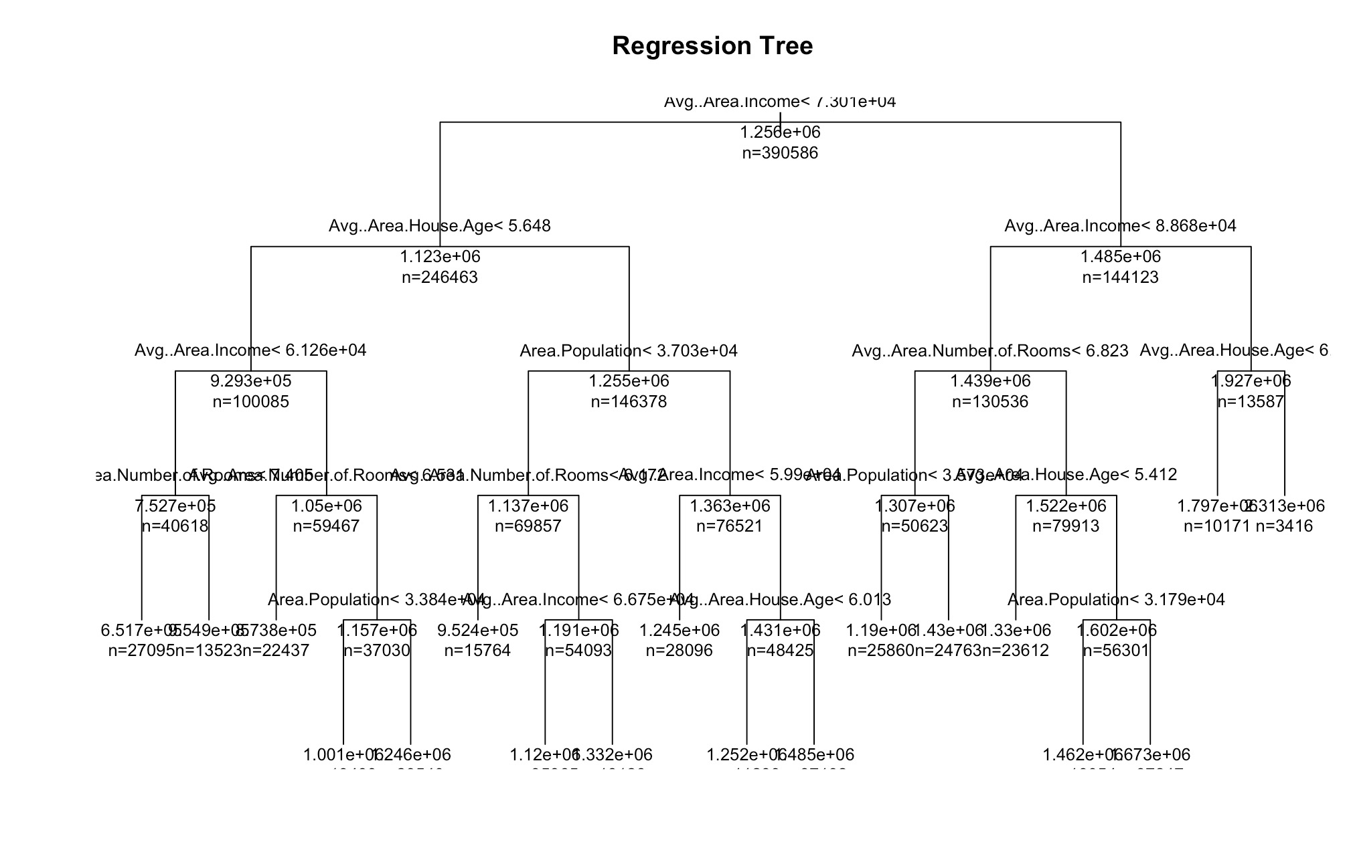
Regression Tree: Interpretable and quick to train; limited in capturing complex relationships without ensemble methods.
Predictive Analysis
Key Results:
-R²: 0.76 (explained 76.28% of the variance in house prices).
-MSE: 2.74×10⁶ (indicating the average squared error between predicted and actual house prices).

Slide 7
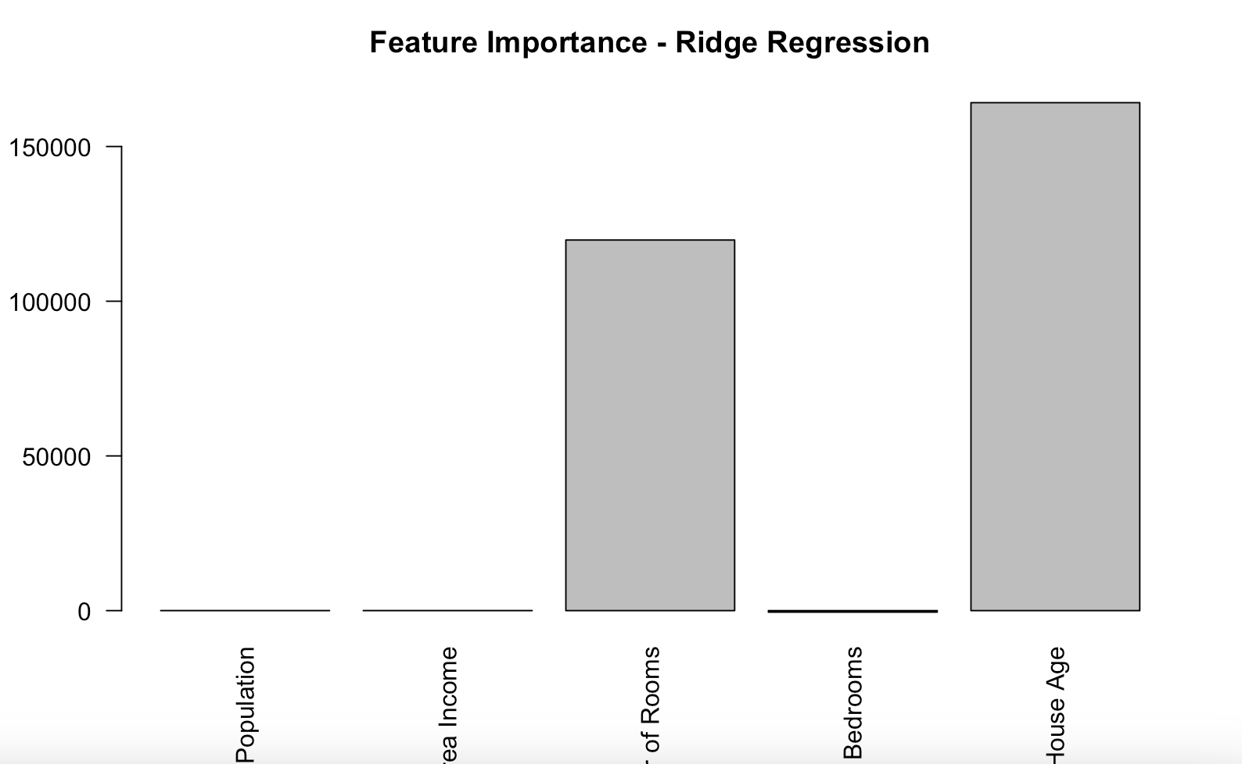
Ridge Regression：Predict house prices and analyze feature importance
Bar Chart
Key Results:
- R²: 0.93 (explained 93% of house price variance).
- MSE: 1.12 × 10⁶ (low error, strong performance).
- No significant outliers: Predicted vs. actual values aligned well.

Slide 8
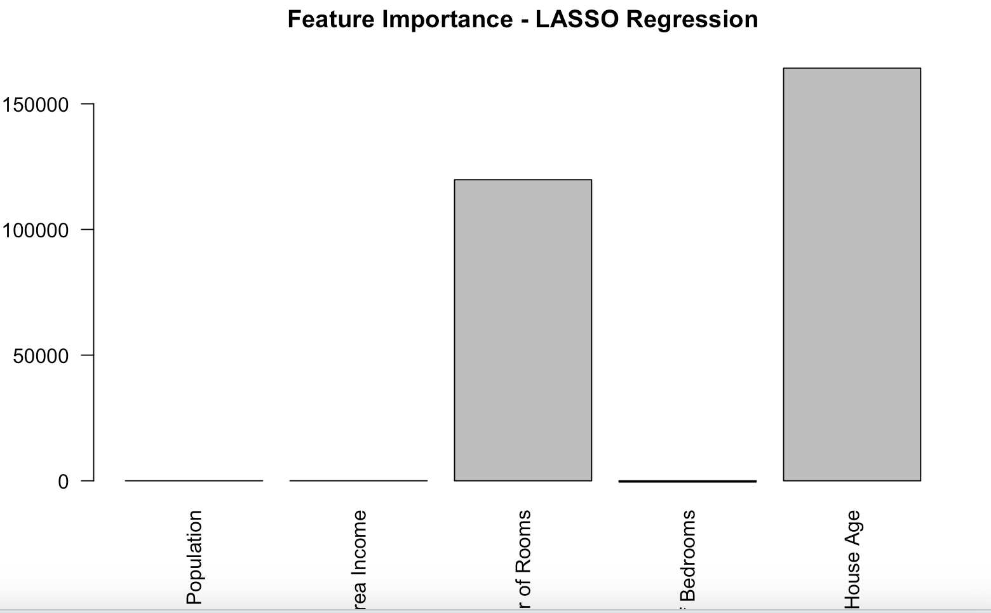
LASSO Regression: Predict house prices and simplify the model by reducing complexity.
Bar chart
Key Results:
- R²: 0.91 (explained 91% of house price variance).
- MSE: 1.23 × 10⁶ (slightly higher than Ridge Regression).

Slide 9
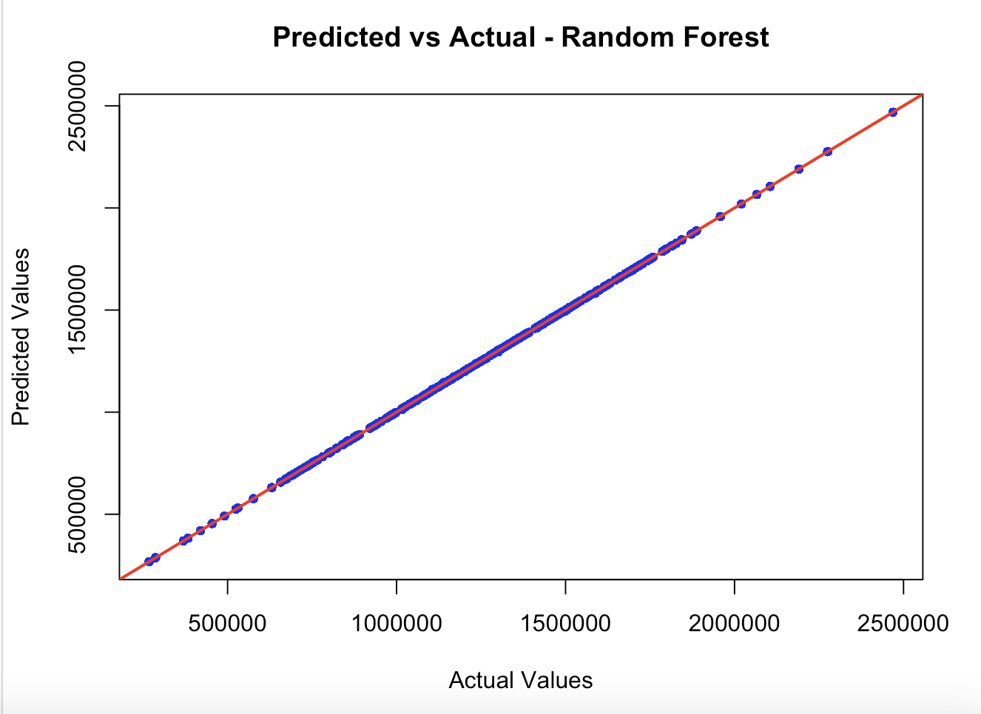
Random Forest: Predict house prices with a highly accurate and robust model.
Scatter Plot
Key Results:
- R²: 0.99 (best-performing model, explaining 99% of variance in house prices).
- MSE: 1.22 × 10⁶ (slightly higher than Ridge Regression but complements the high R²).

Slide 10
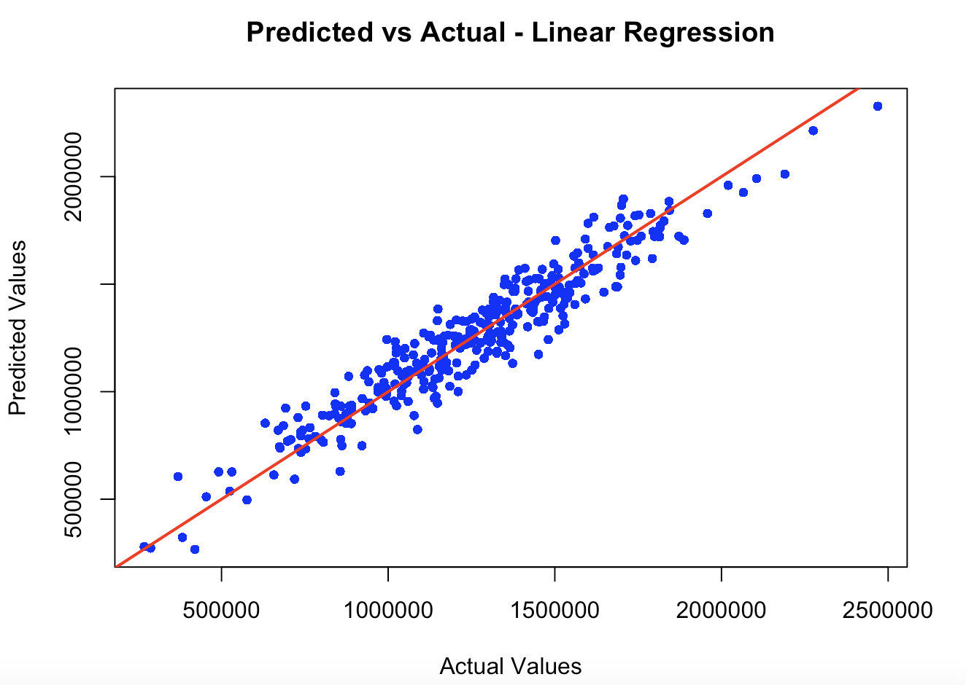
Linear Regression: Predict house prices while maintaining simplicity and transparency.
Scatter Plot
Key Results:
- R²: 0.91 (explained 91% of the variance in house prices).
- MSE: 1.03 × 10⁶ (slightly better than Ridge and LASSO, but may risk overfitting due to no regularization).

Slide 11
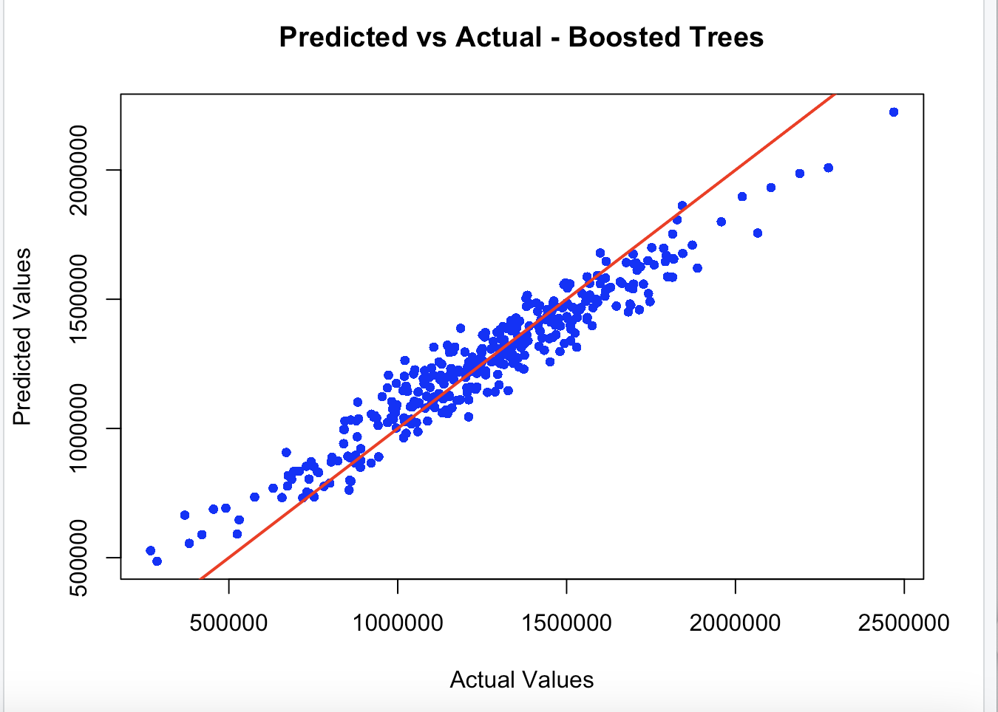
Boosted Trees: Predict house prices with a model that leverages feature interactions and iterative improvements.
Scatter Plot
Key Results:
- R²: 0.92 (explained 92% of the variance in house prices).
- MSE: 1.16 × 10⁶ (slightly better than LASSO and comparable to Ridge).

Slide 12
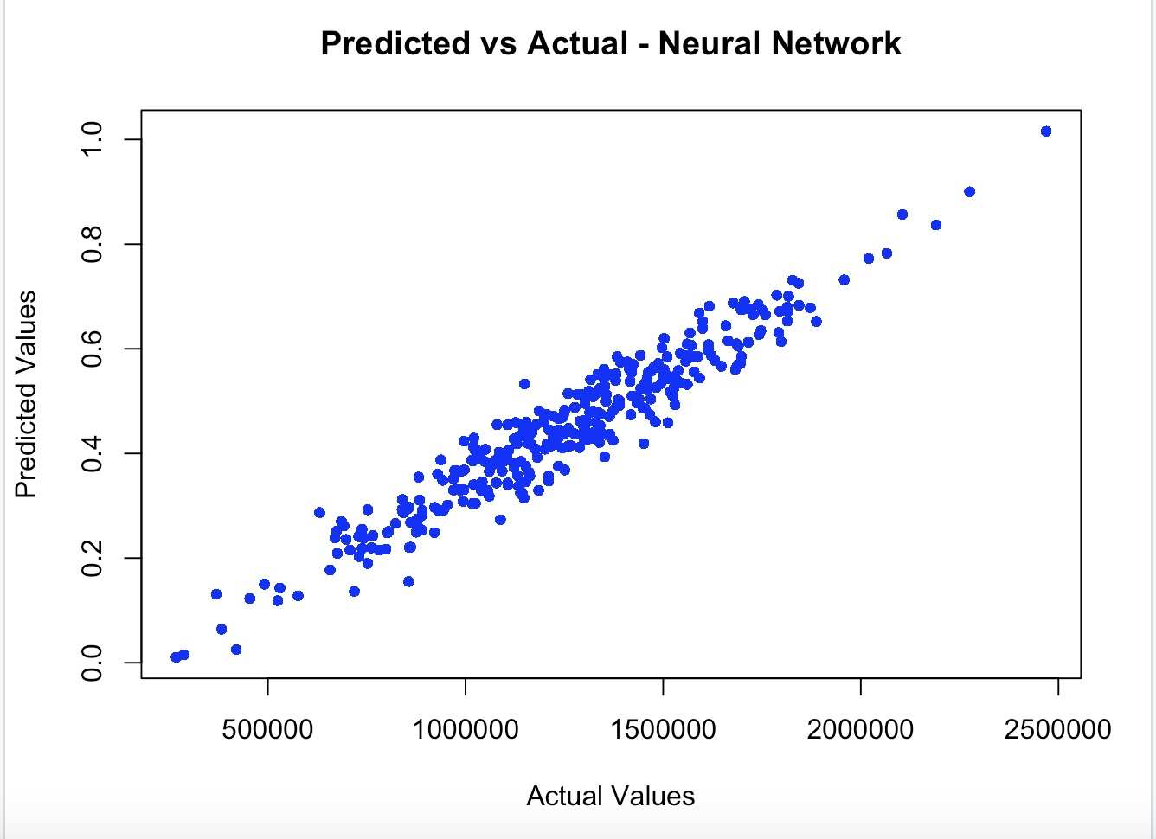
Neural Network: Captures complex non-linear relationships but prone to overfitting; sensitive to scaling and hyperparameters.
Key Results :
-R²: 0.92 (explained 92.47% of the variance in house prices).
-MSE: 1.69×10¹² (indicating the average squared error between predicted and actual house prices).

Slide 13
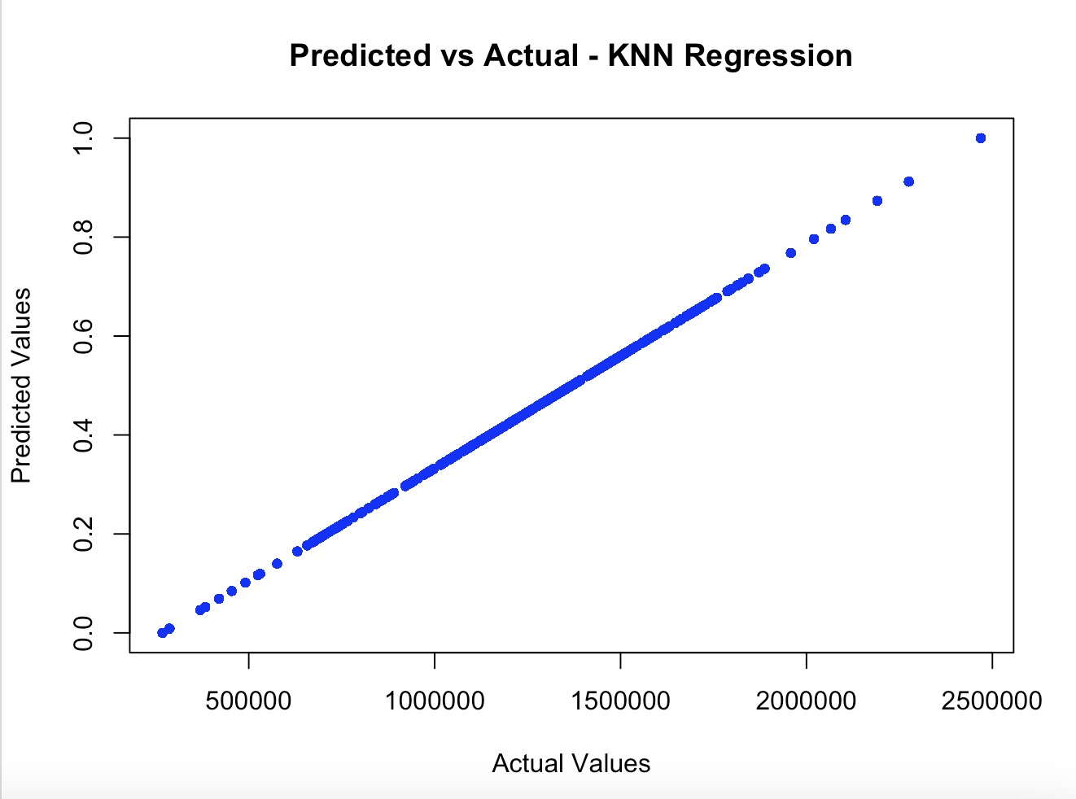
KNN Regression: Simple to implement, effective for small datasets but computationally expensive for large datasets; sensitive to noisy data and scaling.
Key Results:
-R²: 0.9999 (explained nearly all the variance in the test dataset).
- MSE: 1.69×10¹² (higher compared to other models, possibly due to scaling issues or overfitting).

Slide 14
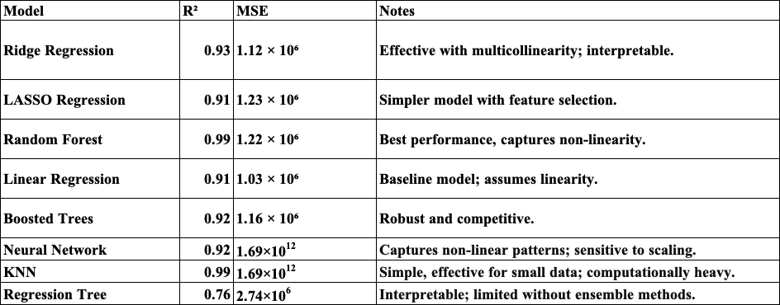
Random Forest. Highest R² with reasonable MSE.

Slide 15
Conclusion
- Population and Income: Significant positive correlations with housing prices; income plays a dominant role.
- Number of Bedrooms: Limited influence compared to income and population.
- Model Evaluation:
* Random Forest: Best performer with R² = 0.99, explaining 99% variance.
* Ridge Regression: Strong predictive power with a balance of simplicity and performance.
* Neural Networks & KNN: Capture complex relationships but prone to overfitting/scaling issues.
- Implications: Insights provide strategic guidance for real estate, financial, and policy decisions.

Slide 16
Reference
Peer-Reviewed Journals
1. Breiman, L. (2001). Random Forests. Machine Learning, 45(1), 5–32. https://doi.org/10.1023/A:1010933404324
2. Tibshirani, R. (1996). Regression Shrinkage and Selection via the Lasso. Journal of the Royal Statistical Society: Series B (Methodological), 58(1), 267–288.
3. Glaeser, E. L., & Gyourko, J. (2005). Urban Decline and Durable Housing. Journal of Political Economy, 113(2), 345–375.
4. Mankiw, N. G., & Weil, D. N. (1989). The Baby Boom, the Baby Bust, and the Housing Market. Regional Science and Urban Economics, 19(2), 235–258.
5. Sirmans, G. S., Macpherson, D. A., & Zietz, E. N. (2005). The Composition of Hedonic Pricing Models. Journal of Real Estate Literature, 13(1), 3–43.
6. Case, K. E., & Shiller, R. J. (2003). Is There a Bubble in the Housing Market? Brookings Papers on Economic Activity, 2003(2), 299–362.
7. Goodman, A. C., & Thibodeau, T. G. (2003). Housing Market Segmentation and Hedonic Prediction Accuracy. Journal of Housing Economics, 12(3), 181–201.
8. Rosen, S. (1974). Hedonic Prices and Implicit Markets: Product Differentiation in Pure Competition. Journal of Political Economy, 82(1), 34–55.
Practical Resources
1. Scikit-learn Documentation. “Random Forests.” Scikit-learn User Guide. Available at: https://scikit-learn.org/stable/
2. Hastie, T., Tibshirani, R., & Friedman, J. (2009). The Elements of Statistical Learning: Data Mining, Inference, and Prediction. Springer.

